Slide 1
Databases
Lecture 12
Non-relational databases: Redis, ClickHouse, MongoDB

Slide 2
0. Some extra words about Neo4j

Slide 3
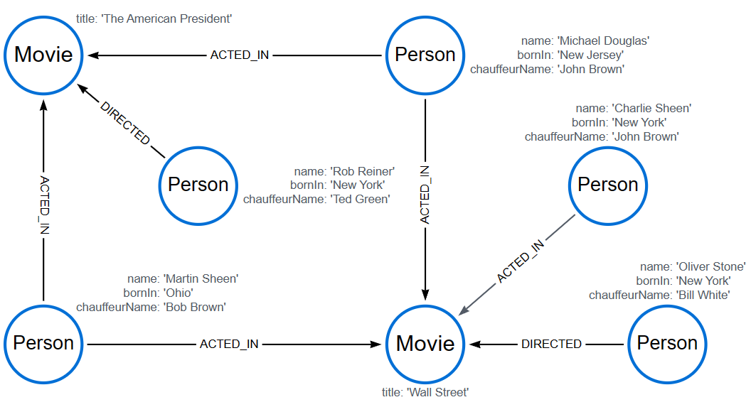
Let's imagine that we are importing data from a relational database into Neo4j
In Neo4j, it is more rational to distribute records from the table across separate nodes. Thus, each node in its header will contain the name of the relationship from the RDB, and in its properties - one record from the table. This allows duplication of nodes with the same headers (labels)
Документация по языку запросов Cypher - Cypher Cheat Sheet - Neo4j Community Edition

Slide 4
I. A short addition about licenses

Slide 5
At the moment, not all software products are equally accessible. When choosing a particular solution, be sure to pay attention to the project licenses and the “edition” of the delivery
The easiest way to find license information as a first approximation is an English-language Wikipedia article about the product you are using.
Consider the environment in which you plan to deploy the service. For example, the Yandex cloud supports MongoDB 5.0 and 6.0 server clusters in the Enterprise edition

Slide 6
II. Reddis

Slide 7
Redis = Remote Dictionary Server
This is a key-value store in RAM
Possibility of saving to disk
Supports replication according to the master-slave scheme. There is a main node with which work is carried out - master, and there is also a slave to which replication occurs.
Supports the event mechanism according to the “publish-subscribe” scheme
Written in C, libraries available for many languages
Runs on Unix-like OS
There is a port for Windows, which works with reservations, but is suitable for development
The code is open source on Github

Slide 8
Redis
Architecture:
redis-server is a process responsible for processing and storing data in RAM (by default the process listens to 127.0.0.1:6379)
redis-cli – interactive terminal utility
Some commands:
redis-cli -h 127.0.0.1 -p 6379 – connection to the database
Adding data, getting data:
SET bike:1 "Process 134"
GET bike:1
Adding data as a dictionary and getting the field value:
HSET bike:1 model Deimos brand Ergonom type 'Enduro bikes' price 4972
HGET bike:1 model
->"Deimos"

Slide 9
Redis
Why do we need Redis?
The first option is to use it as a cache
Why not keep the data in application memory? The answer here is quite simple - the data in the application memory will be constantly cleared when the application is stopped. This way Redis gives cache resiliency.
Ability to scale the system
If the cache is in the application's memory, it cannot be used across multiple instances of the application.

Slide 10
III. ClickHouse

Slide 11
ClickHouse
ClickHouse is a “columnar database management system (DBMS) for online analytical query processing (OLAP)”
Properties:
“A truly columnar DBMS” ☺
Data compression
Storing data on disk
Parallel request processing on many processor cores
Large queries are naturally parallelized, using all the necessary resources available on the server
SQL support
ClickHouse supports a declarative query language based on SQL and in many cases aligned with the SQL standard.
GROUP BY, ORDER BY, subqueries in FROM, IN, JOIN sections, window functions, as well as scalar subqueries are supported.
Dependent subqueries are not supported but may become available in the future.

Slide 12
ClickHouse
Potential disadvantages:
Lack of full-fledged transactions
There is no ability to modify or delete previously recorded data with low latency and high request rates. There is a mass deletion and modification of data to clear what is no longer needed
The sparse index makes ClickHouse poorly suited for point reads of single rows against its keys

Slide 13
ClickHouse
Some commands:
Connection: clickhouse-client -d example_db
Creating and filling a table:
CREATE TABLE example_table (
id Uint32,
name String,
age Uint32
) ENGINE = MergeTree() ORDER BY id;
INSERT INTO example_table (id, name, age) VALUES (1, 'Alice', 25), (2, 'Bob', 30), (3, 'Charlie', 35);

Slide 14
ClickHouse
Some commands:
ClickHouse does not support traditional row deletion using DELETE; instead, data filtering is used through table alteration mechanisms. However, you can use ALTER TABLE to delete rows based on conditions:
ALTER TABLE example_table DELETE WHERE age > 30;

Slide 15
IV. MongoDB

Slide 16
MongoDB
Data is stored as documents in a JSON-like (BSON) format. Each document may have a different structure. Fields in documents can vary, making it easy to change the data structure.
Optimal support for horizontal scaling: MongoDB supports sharding - data can be distributed across multiple servers for horizontal scaling.
Transaction support available: Since version 4.0, MongoDB supports multi-document ACID transactions

Slide 17
MongoDB
Some example commands:
mongo – connection to a process
use <DB_name>– context switching or creating a database
db.users.insert({"name": "John", "age": 30, "email": "john@example.com"}) - adding data to the users collection
db.users.remove({"name": "John"}) – removal
db.users.findOne({"name": "John"}) – search for one document by criterion
db.users.find({"age": {"$gt": 20}}) – search for all documents by criterion
db.users.createIndex({"email": 1}) – creating an index on a field
db.users.aggregate([{"$group" : {"_id": "$age", "count": {"$sum": 1}}}]) - aggregation for grouping data by age and counting the number of users in each group

